Slide 1
Classification of E.coli proteins.
MSDS696_X70_Data Science Practicum II
Regis University
WEEK 8: – Project Presentation.
Eric Mwangi
Email: Mwang386@regis.edu

Slide 2
High level description of the project:
The project will classify E.coli proteins into various cellular class distributions (multi-class classification) based on their amino acid sequences.
The question being addressed is how well a classification system like the support vector machine (SVM) can classify the E.coli proteins.
This will be compared to predicted labels based on a model trained by Random forest.
The results of the SVM and Random forest models will be compared to the results obtained by Horton & Nakai’s model (which achieved an accuracy of 81%).

Slide 3
Project Links:
GitHub repository:
https://github.com/mwangi02/MSDS696-Data-Science-Practicum-II.git
Reference:
Horton, P., & Nakai, K. (1996). A Probabilistic Classification System for Predicting the Cellular Localization Sites of Proteins. ISMB-96 Proceedings, 109 – 115. Retrieved from https://www.aaai.org/Papers/ISMB/1996/ISMB96-012.pdf
Data Source – From the UCI Machine Learning Repository:
https://archive.ics.uci.edu/ml/machine-learning-databases/ecoli/

Slide 4
Project Milestones:
Project proposal (Scope) – (Done)
Updating R environment – (Done)
Data collection – (Done)
Exploratory Data Analysis (EDA) – (Done)
Data cleaning – (Done)
Build models: SVM, Random forest – (Done)
Hyper parameter optimization – (Done)
Result visualization – (Done)
Class Presentation
GitHub Repository

Slide 5
Data: Brief description of data.
The data will be analyzed using R, which is a good statistical data analysis tool with good packages for machine learning methods.
The data file is ecoli.data and has 336 rows with 9 columns (9 attributes - 8 predictive and 1 name).
There are 8 class distributions. The class is the localization site. We are going to classify on the class distribution.
The ecoli.names file describes the data structure, attribute Information, and the class distribution (the class is the localization site).

Slide 6
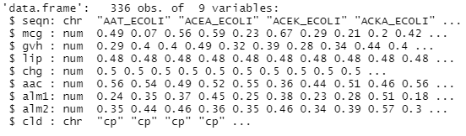
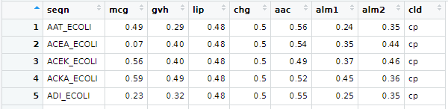
Exploratory Data Analysis (EDA):
Using summary statistics Graphs.
Look at the data structure and the view:
str(ecoli_df)
view(ecoli_df)
Notes:
Look at the Data structure using the str() function.
Data frame with 336 observations and 9 variables.
Sequence number and the class distribution are characters (discrete) while the other attributes are numeric (continuous).

Slide 7
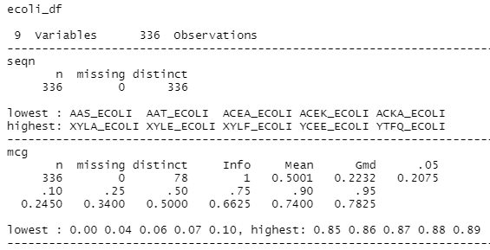
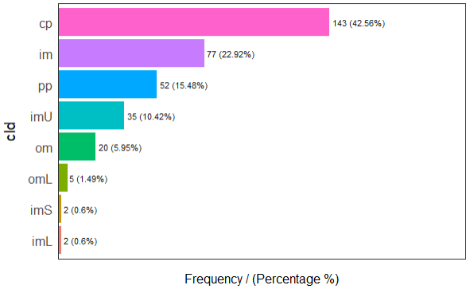
EDA (CONT):
describe(ecoli_df)
freq(ecoli_df)
Notes:
We describe the data to get some summary statistics.
The same information is easily observed in a graph using freq() function.

Slide 8
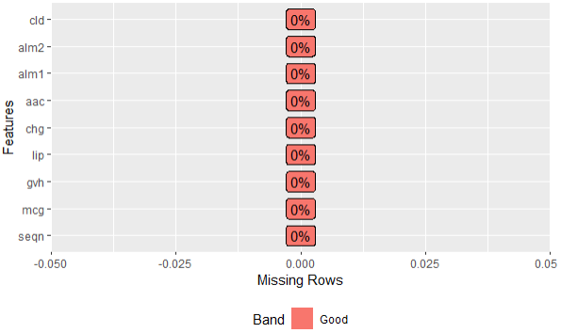
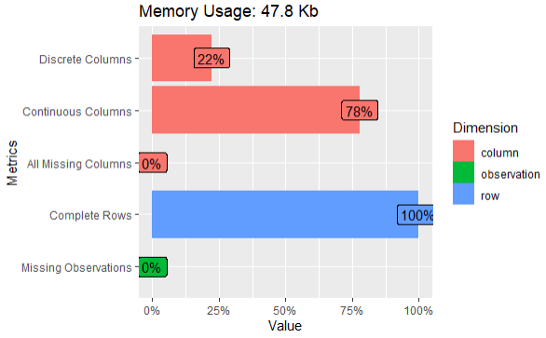
EDA - Check for missing data:
plot_missing(ecoli_df)
plot_intro(ecoli_df)
Notes:
Check for missing data.
Using the plot_missing() function, we observe there are no missing data in all the rows.
Using the plot_intro() function, we observe the summary statistics of all the columns and rows, and there are no missing data.

Slide 9
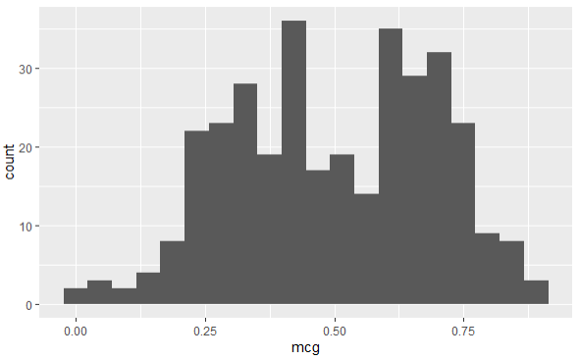
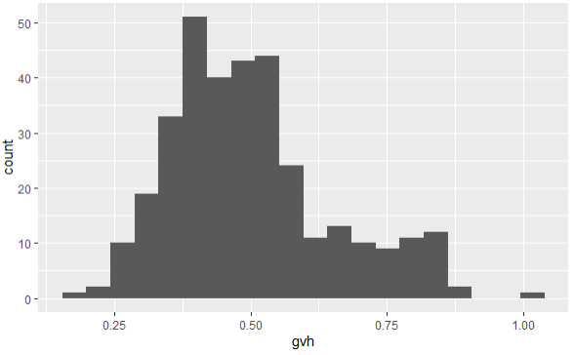
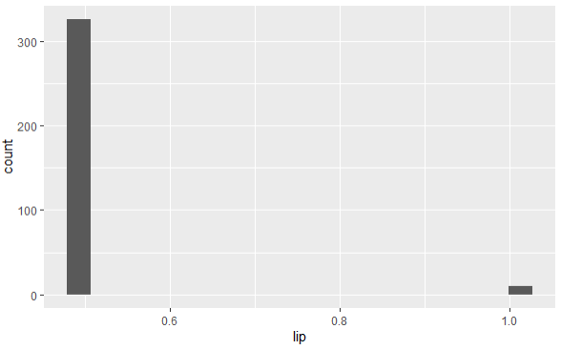
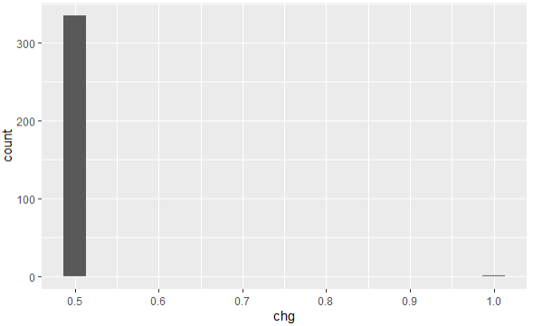
EDA - Histogram of the variables:
ecoli_df %>%
ggplot(aes(x=mcg)) +
geom_histogram(bins=20)

Slide 10
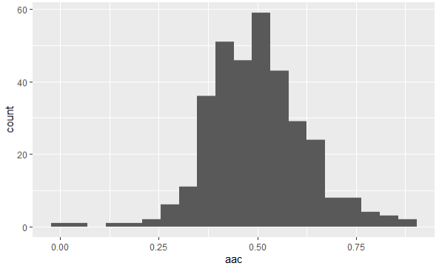
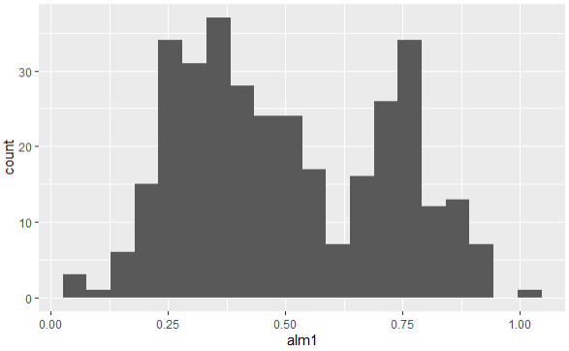
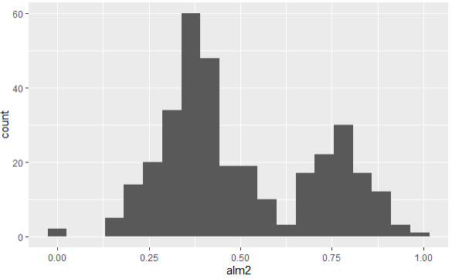
EDA - Histogram of the variables:
Notes:
We observe that the amino acid content is symmetrical while the score of ALOM membrane (alm1 – spanning region prediction) and the score of ALOM program (alm2 – after excluding the regions assumed to be capable of being split from the sequence) are bi-modal.

Slide 11
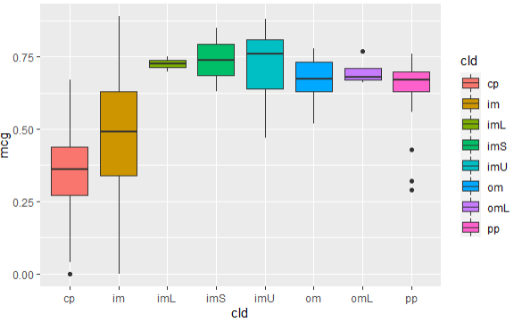
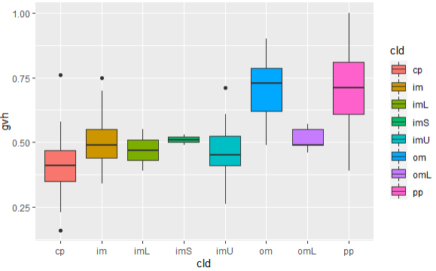
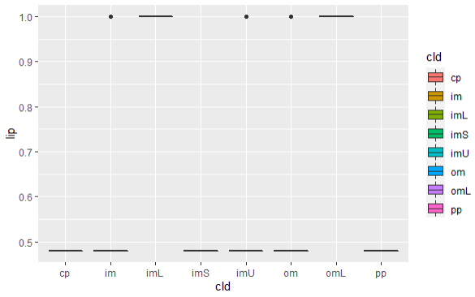
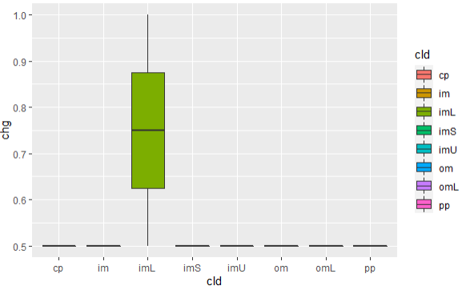
EDA - Box and whisker plots:
qplot(cld, mcg, data=ecoli_df, geom="boxplot", fill=cld)

Slide 12
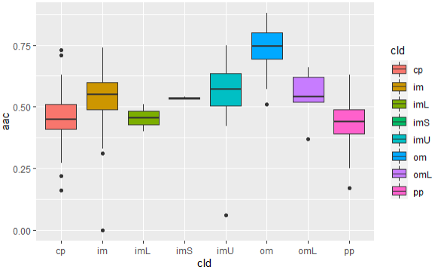
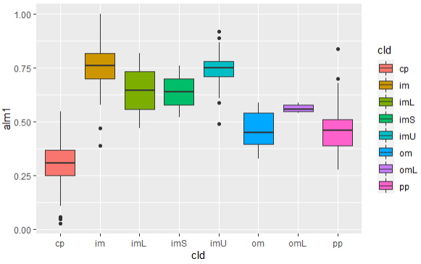
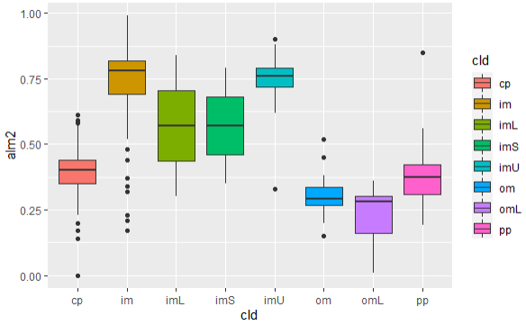
EDA - Box and whisker plots:

Slide 13
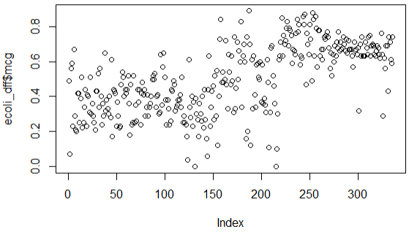
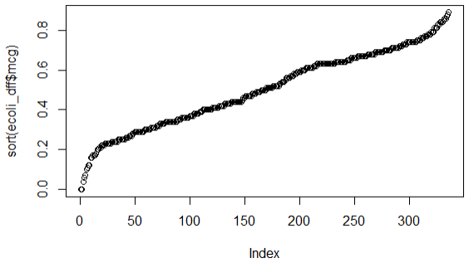
EDA - Plotting Vectors and quantile-quantile (Q-Q) plots:
plot(ecoli_dff$mcg) # Plot proteins for each observation.
plot(sort(ecoli_dff$mcg)) # Plot values against their ranks.
Notes:
The plots above indicate a distribution with “heavy tails” versus a Normal distribution:
The points fall along a line in the middle of the graph, but curve off in the extremities.
Normal Q-Q plots that exhibit this behavior usually mean your data have more extreme values
than would be expected if they truly came from a Normal distribution.

Slide 14
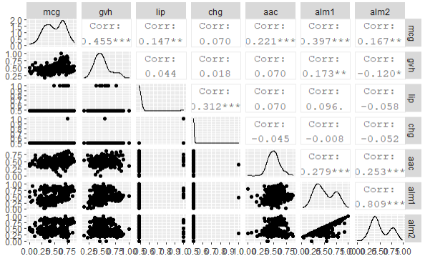
EDA - Correlation matrix using pairs plots:
ecoli_dfc <- ecoli_df[, c(2,3,4,5,6,7,8)]
ggpairs(ecoli_dfc)
Notes:
Correlation matrix, which is a handy way of quickly finding out which variables in a dataset are correlated with each other.
We observe that alm1 and alm2 have a high correlation.

Slide 15
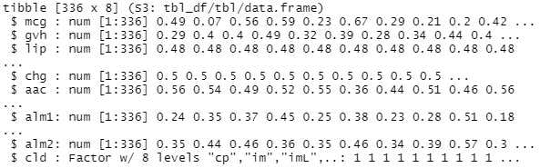
Data Cleaning:
The Class Distribution ("cld") is the outcome we hope to classify.
Many R machine learning classifiers require that the target feature is coded as a factor.
Convert "cld" field as the class factor.
Notes:
The Class Distribution ("cld") is the outcome we hope to classify. This feature indicates the protein classification.
Many R machine learning classifiers require that the target feature is coded as a factor, so we will need to recode the cld variable.

Slide 16
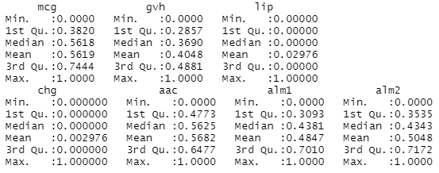
Data Cleaning – Standardization:
We Apply normalization to rescale the features to a standard range of values.
summary(ecoli_norm)
Notes:
All kernel methods are based on distance. Hence, it is required to scale our variables. If we do not standardize our variables to comparable ranges, the variable with the largest range will completely dominate in the computation of the kernel matrix.
Another reason of standardization is to avoid numerical difficulties during computation. Because kernel values usually depend on the inner products of feature vectors.
We Apply normalization to rescale the features to a standard range of values.

Slide 17
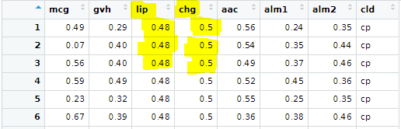
Data Cleaning – Standardization:
The “chg” variable is constant. The “lip” variable is also constant:

Slide 18
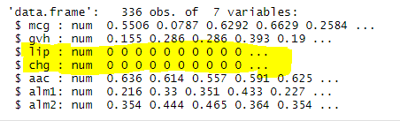
Data Cleaning – Standardization:
The normalized data for the two variables were zeros.
Notes:
Since the variables are not adding any meaningful information, I will drop the two variables and proceed with building the model.

Slide 19
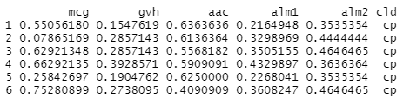
Data Cleaning – Standardization:
I dropped the “chg” and the “lip” variables as they were constants (not adding any meaningful information).

Slide 20
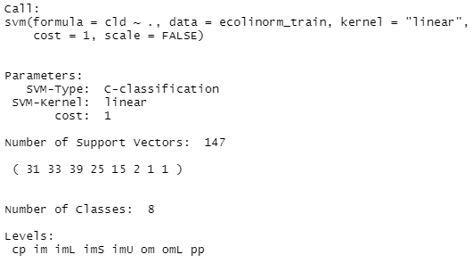
Build Models – svm linear model (with a cost of 1).
summary(ecoli.linmodel)

Slide 21
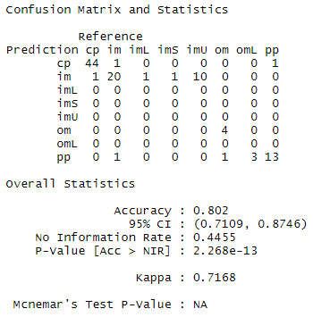
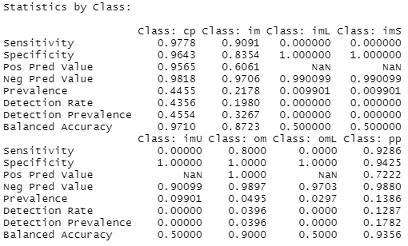
Build Model – svm linear model (confusionMatrix ).
confusionMatrix to measure the prediction performance based on the classification table.
Notes:
Use confusionMatrix to measure the prediction performance based on the classification table.

Slide 22
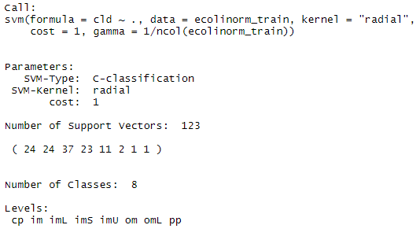
Build Models – svm radial model (with a cost of 1).
summary(ecoli.radmodel)
Notes:
Improving model performance.
We use the radial kernel (similar to Gaussian RBF kernel.

Slide 23
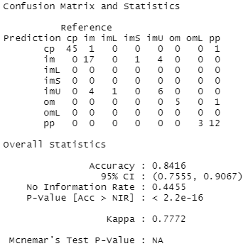
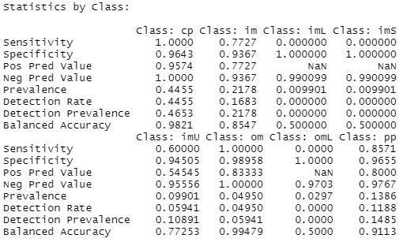
Build Models – svm radial model (confusionMatrix ).
confusionMatrix to measure the prediction performance based on the classification table.
Notes:
Use confusionMatrix to measure the prediction performance based on the classification table.

Slide 24
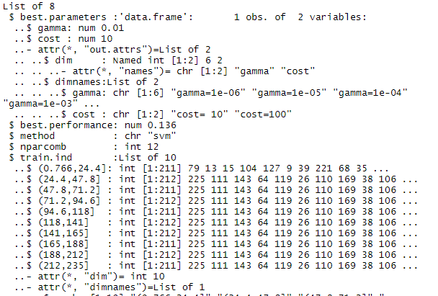
Build Models – tuned svm radial model (train data).
str(svm_tuned)
Notes:
The best tuned model has a gamma of 0.001 and a cost of 10.

Slide 25
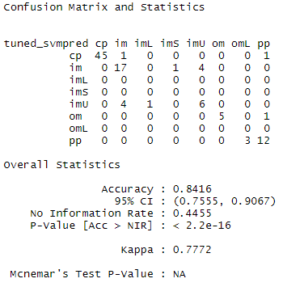
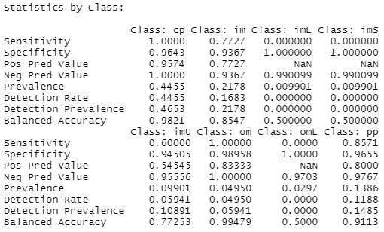
Build Models – tuned svm radial model (confusionMatrix ).
confusionMatrix to measure the prediction performance based on the classification table.
Notes:
Use confusionMatrix to measure the prediction performance of the tuned svm model based on the classification table.
The model has an accuracy of 84.2% with a confidence interval of 95%, with a kappa of 0.78 (which is a “good agreement” in predicting the protein class classification and the actual values).

Slide 26
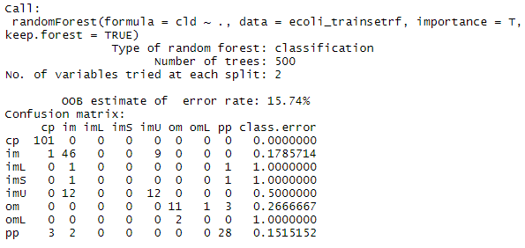
Build Models – random forest model (train data):
Confusion matrix
Accuracy:
0.9829787
Notes:
We use the random forest method to train a classification model. We set importance = T, which will ensure that the importance of the predictor is assessed.

Slide 27
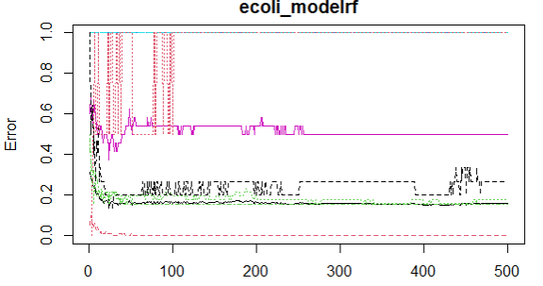
Build Models – random forest model:
plot the mean square error of the forest object:
Notes:
Flat line - even if run more trees, won't make a difference in the model.

Slide 28
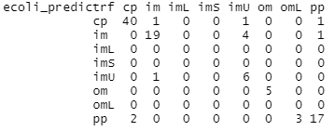
Build Models – random forest model (test data):
Confusion matrix
Accuracy:
0.8613861
Notes:
We use the random forest method to train a classification model. We set importance = T, which will ensure that the importance of the predictor is assessed.

Slide 29
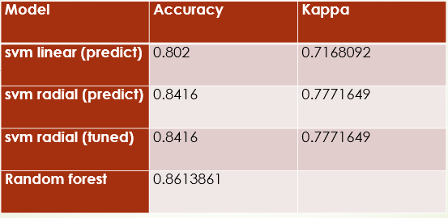
Summary – Model comparison:
We achieved ~86.1% accuracy with Random forest:
Notes:
Flat line - even if run more trees, won't make a difference in the model.

